Slide 1
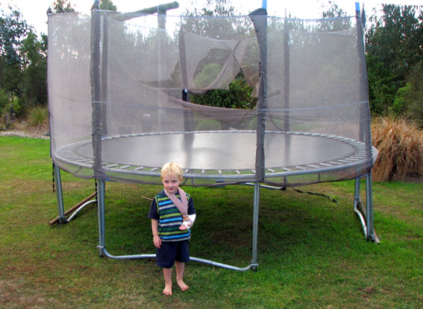
Reducing Injury to Children Caused by Trampolines

Slide 2

The Ultimate Exercise...
10 minutes trampolining = 33 minutes running
NASA studies in 1980 revealed rebound trampolining as an extremely effective exercise, showing that 10 minutes bouncing on a trampoline was equivalent to 33 minutes of running, in exercise benefit.
Ref. 1 - see slide 22

Slide 3

Or the Ultimate Danger?...
The following year, in 1981, the American Academy of Pediatrics called for a total ban of trampolines for home and recreational use,
in response to the alarming rate of injuries caused by trampolines.
Ref. 2 - see slide 22

Slide 4
Approximately 1 million trampolines are sold in USA each year
Ref. 3 - see slide 22

Slide 5
The instance of injury closely matches the number of trampolines in existence. Around 100,000 hospitalisations per year in USA.
(Assumes no change to injury performance, as found in Eager et al 2010)
Emergency Department figures are recorded, but the number of injuries not presented to ED’s is estimated to be at least twice this number.
Ref. 4 - see slide 22

Slide 6

That is a lot of injury...
So why not impose measures to make trampolines safer?... set safety standards for pads and enclosure nets, and make them compulsory for all new trampolines… well, in 1998 and 2003 the USA did.
ASTM Trampoline Standards
for pads were set in 1998,
upgraded in 1999 and a
standard for enclosure
nets was introduced 2003

Slide 7
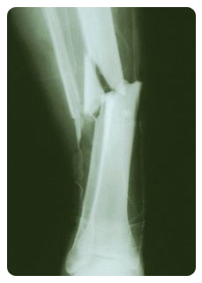
So injury rates should have come down…
But they didn’t.
Safety pads should have prevented injuries by the frame and springs, and
Enclosure nets should have prevented injuries from falling off.
BUT after ten years of the ASTM standard
being in place in USA…
Injuries in these areas
HAVE NOT DECLINED.
Ref. 5 - see slide 22

Slide 8
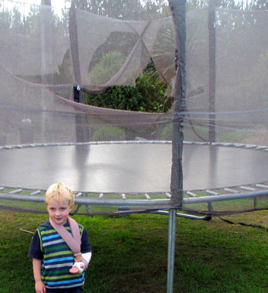
So why didn’t the intended safety measures work?
One reason is there is no minimum lifespan requirement for pads and nets – it is deemed ‘acceptable’ that pads & enclosure nets be allowed to deteriorate far more quickly than the rest of the trampoline, leaving them significantly more dangerous.
If vehicle seat belts were only effective for the initial period of a vehicle’s life it would be unacceptable – yet this is the case with trampolines.

Slide 9
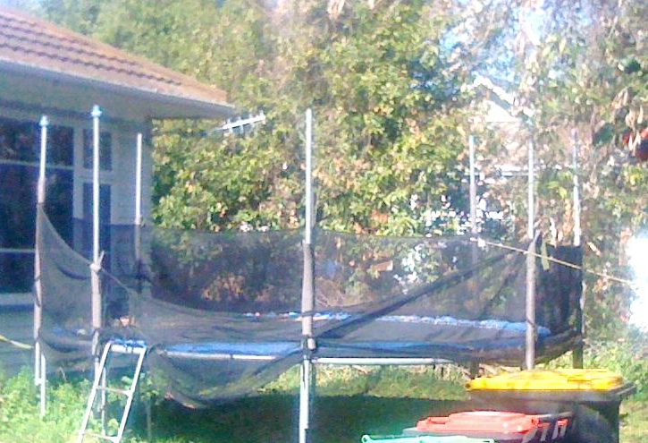
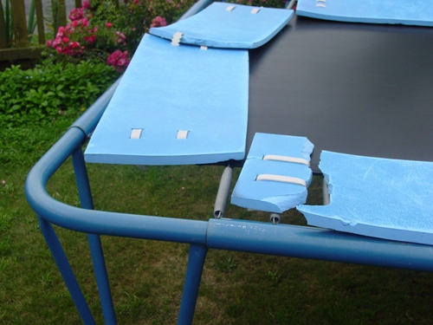
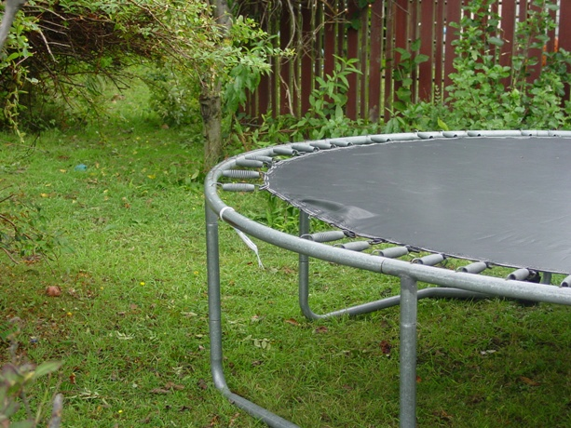
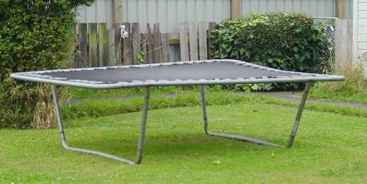
4 cases within a
2km radius

Slide 10
But if pads are there, surely they will prevent injuries?
At the allowable playground standard (F1292), a head hitting a safety pad above the frame from 1.5m (about the height of a trampoline free-fall) has a:
99% chance of ‘minor’ injury – which includes fracture, broken teeth and skull trauma
90% chance of ‘moderate’ injury – which includes deep wounds, skull fracture and loss of consciousness
3% chance of critical injury – brain damage, coma
1% chance of death
These are the accepted ‘safety’ thresholds.
Ref. 6 - see slide 22

Slide 11
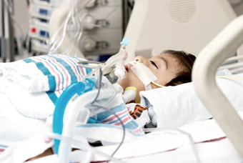
But wait, it gets worse…
3% 16% chance of critical injury – brain damage, coma
Further studies suggest that chance of critical injury at the 1000HIC threshold actually produces a 16% chance of critical injury rather than 3% stated in the previous slide.
If so, the injury risk is
significantly higher over
all categories, including
chance of fatality, than
previously thought.
Ref. 7 - see slide 22

Slide 12
But wait, it gets worse still…
Those figures are for adults, not kids.
The allowable threshold was devised from head impact studies in the 1950’s using primates and cadavers to emulate the impact of head injury of adult males in vehicle accidents.
The Huber study strongly recommends the minimum threshold be reduced for children to two thirds of the adult level for 5 to 12 year olds, and to half the adult level for 2 to 5 year olds.
Or to put it another way…. The current allowable threshold is totally unsuitable for kids.
Ref. 7 - see slide 22

Slide 13
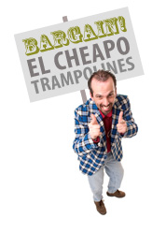
But wait, it gets EVEN worse!… (for Australia and NZ at least)
In Australia and New Zealand, safety standards are VOLUNTARY, not mandatory.
So any trampoline, of any quality, can be sold without a minimum safety requirement in place to protect kids at all!

Slide 14
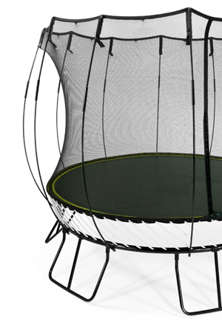
It’s not all bad news…
In 2012, the Journal of Paediatrics and Child Health reported that trampoline injuries can be reduced by 36-79% purely through product engineering & design.
Ref. 8 - see slide 22

Slide 15
The Soft-Edge design employed by Springfree Trampolines is 99% less likely to cause injury:
Playground Standard F1292 allowable limit (1000HIC):
99% chance of minor injury (fracture, broken teeth)
(Impact at the edge of trampoline at the previously mentioned 1.5m fall height)
vs
The Springfree Soft-Edge design (77HIC):
1% chance of minor injury (fracture, broken teeth)
(Impact at the edge of trampoline at the previously mentioned 1.5m fall height)
Ref. 9 - see slide 22

Slide 16
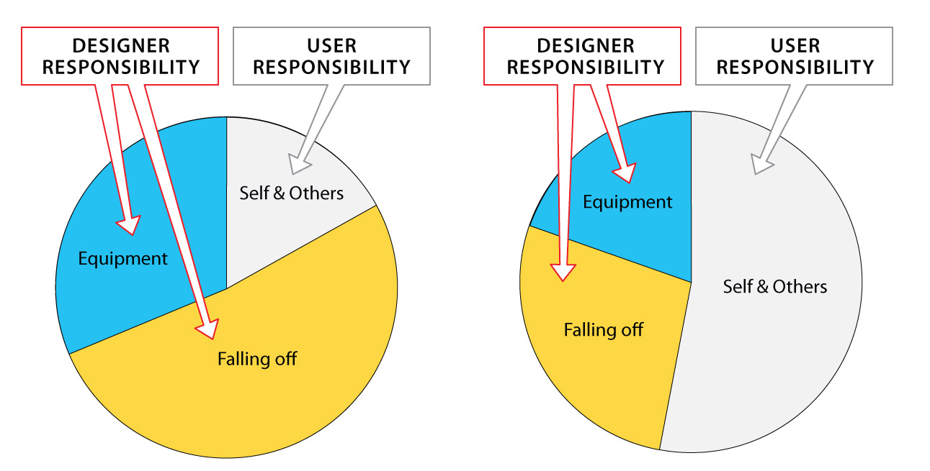
How injuries occur
Traditional spring-based trampolines
Australia USA
Pie charts showing sources of injury in traditional trampolines in USA & Australia
Ref. 10 - see slide 22

Slide 17
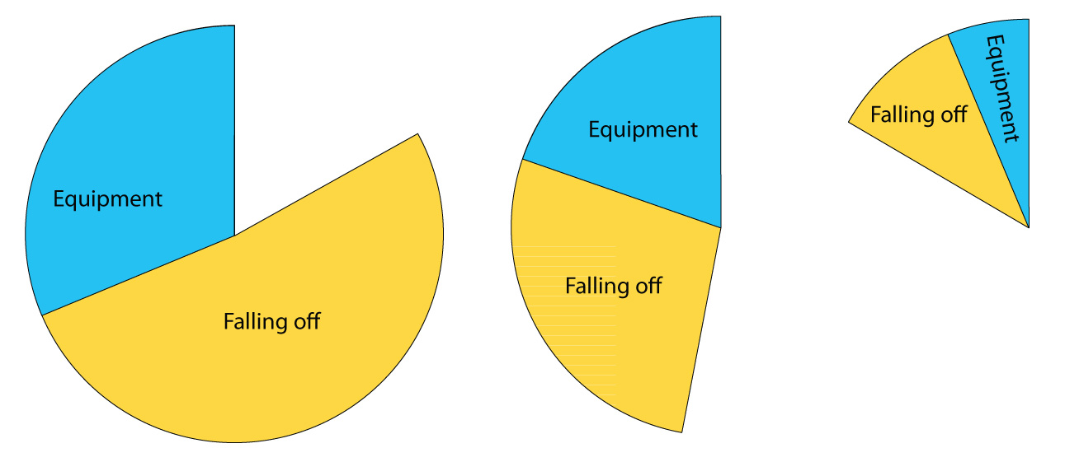
Designer responsibility: Avoidable Injuries
Traditional spring-based trampolines
Australia 83%
Traditional spring-based trampolines
USA 48%
Springfree
Trampolines
17%
Avoidable by Design

Slide 18
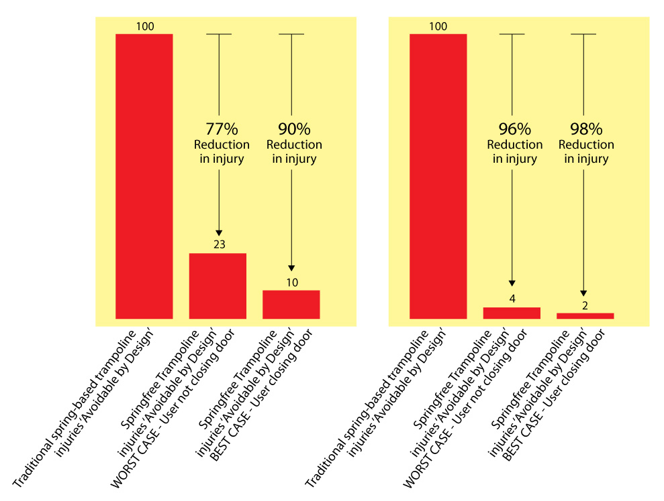
Designer responsibility: Avoidable Injuries
USA
Australia
Taking ‘Avoidable injuries’ as 100%....
For every 100 injuries generated by traditional spring-based trampolines, Springfree’s design delivers the following reduction :
Ref. 11 - see slide 22

Slide 19
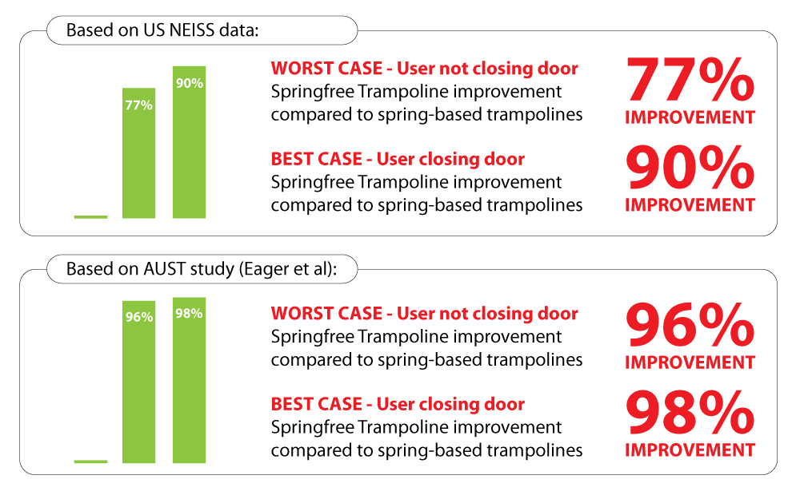
Designer responsibility
Springfree Improvement as % of ‘Avoidable by Design’
(ie. injury caused by impact with equipment or falling off - things that can be influenced by trampoline design)

Slide 20
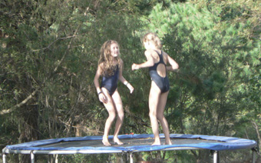
Manufacturers cannot
control user behaviour,
but they can control
design and safety features.
Springfree’s design aim is to eliminate all falling-off and equipment-related injuries.

Slide 21
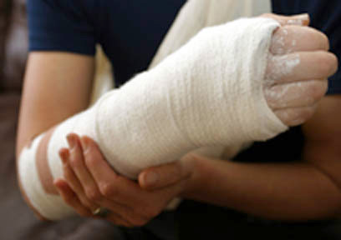
Thousands of children are injured each year as a result of poor design, poor quality products, and lack of effective safety standards.
We think our kids deserve better.

Slide 22
References:
1 (Slide 2) - Journal of Applied Physiology 49(5): 881-887
2 (Slide 3) - Pediatrics 1981;67:438
3 (Slide 4) – ITIA and Bed Fabric Manufacturers
4 (Slide 5) – National Electronic Injury Surveillance System (NEISS). Patient information is collected from each NEISS hospital for every emergency visit involving an injury associated with consumer products. Alexander: Unpublished analysis of US trampolines in existence.
5 (Slide 7) – Effectiveness of pads and enclosures as safety interventions on consumer trampolines; Eager, Alexander, Scarrott, Sushinsky
6 (Slide 10) – Probability data published within the ASTM-F1292-04 Standard. This forms the allowable/acceptable maximum threshold of 200Gs and 1000HIC (Head Impact Criteria)
7 (Slides 11 & 12) – Rolf Huber: Impact Attenuation Values and Prevention of Head Injuries in Children’s Playgrounds. ASTM Tampa, Nov 2011
8 (Slide 14) – Eager et al 2012: “Injury survey for a trampoline with equipment hazards designed out”, Int Journal of Paediatrics and Child Health
9 (Slide 15) – NATA Accredited Laboratory: “Acousto-Scan” Australia: Test Report 1930; December 2004
10 (Slide 16) – Eager, Scarrott, Nixon, Alexander: “Injury survey for a trampoline with equipment hazards designed out”, Int Journal of Paediatrics and Child Health doi:10.1111/j.1440-1754.2012.02426.x
11 (Slide 18) – USA NEISS data; Wallis BA, Acton CHC, Nixon JW, Eager D. “Trampolines: Cause for Concern?” 7th Australian Injury Prevention Network Conference McKay QLD, July 04

